Slide 1

MODULE TITLE: MACHINE LEARNING
MODULE CODE: GENML801
RQF LEVEL: 8
DEPARTMENT: ETT
PROGRAM: Electrical and Electronics Engineering
Competence: Apply Machine Learning Technology
Module leader: MUKAMANA Florentine
ACADEMIC Year: 2025-2026

Slide 2
AI-Based Early Fire Detection using Image Processing
Case Study: Gakiriro Wood Furniture Factory, Rwanda
Prepared by: RUKUNDO Janvier
REG NUMBER: 25RP18377
Date: 25/09/2025

Slide 3
Problem Statement
Frequent, high-loss fires at the Gakiriro wood and furniture market in Gisozi, Kigali, expose limits of current smoke and heat detectors, which are often slow, costly, and ineffective, especially at night and in open market spaces. Many market sellers have no insurance and lose their goods and savings. There is an urgent need for an affordable, reliable, 24/7 early-warning system that detects visual fire signs (color, shape, flicker) and sends instant alerts. This project proposes a Raspberry Pi-based AI image-processing solution to detect fires earlier, shorten response time, and reduce damage, scalable to other vulnerable markets and help protect traders' livelihoods.

Slide 4
Why this Problem is Important?
Fires at Gakiriro destroy goods, tools, and people's savings harming families and the local economy.
Current detectors often miss early flames or react too late, especially at night or in open market areas.
Many sellers have no insurance, so losses are direct and severe.
A low-cost, reliable early-warning system can save lives, reduce damage, and keep small businesses running.

Slide 5
Insights from Solving It
Visual detection (flame color, shape, flicker) finds fires earlier than smoke/heat alone.
Raspberry Pi + camera offers a low-cost way to monitor 24/7.
Tune the AI to avoid too many false alarms while keeping sensitivity high.
Clear alerts are essential for real-world use and scaling.

Slide 6
Chosen Dataset
The dataset is called Fire Detection and is hosted on Roboflow Universe. It is a computer vision dataset designed for the classification (fire/no fire) and detection of fire.
Link to dataset: fire detection

Slide 7
Dataset Description
Features:
The features of this dataset are the images themselves. Each image contains pixels that represent a real-world scene.
The dataset also comes with bounding box annotations, which provide the location of the fire within the image.
This is a crucial "feature" as it allows for both classification (is there fire?) and object detection (where is the fire?).

Slide 8
Cont__
Size:
The dataset is comprised of a total of 8,358 images. It is already split into training, validation, and testing sets, which is a standard practice for machine learning projects.
The distribution is as follows:
Training Set: 6,686 images
Validation Set: 836 images
Testing Set: 836 images

Slide 9
Cont__
Target Variable:
The target variable is the presence and location of fire within an image.
This is a binary classification task (fire or no-fire) and an object detection task (locating the fire with a bounding box).
The images are labeled with either 'fire' or 'smoke'.

Slide 10
Exploratory Data Analysis (EDA)
i. Univariate Analysis
This analysis focused on the individual characteristics of the variables in the dataset.
I used bar charts to visualize the class distribution of fire and smoke instances to check for imbalance.
I also created histograms of bounding box dimensions for each class, which revealed that smoke plumes tend to be larger and have a different size distribution than fire instances.

Slide 11
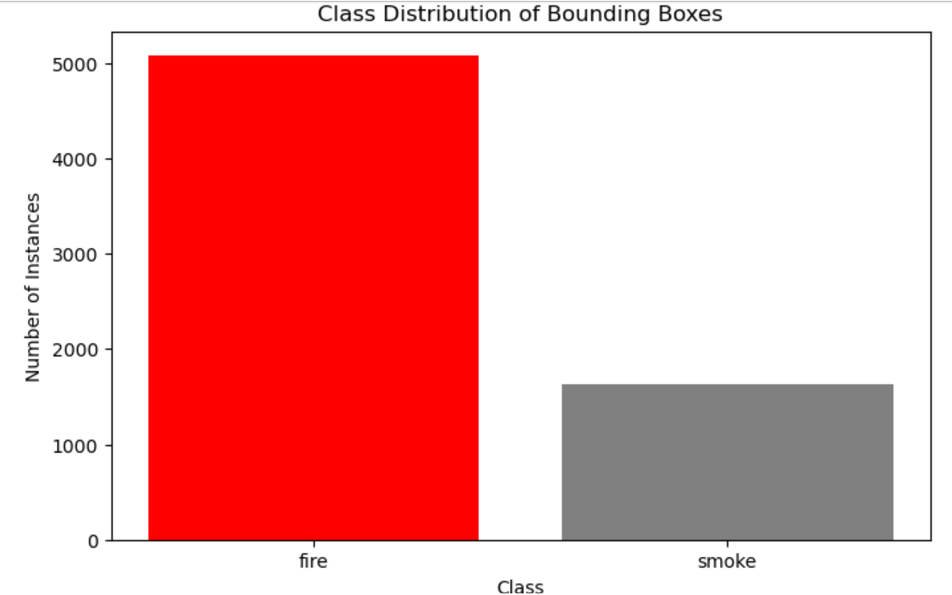
Bar Charts for Class Distribution

Slide 12
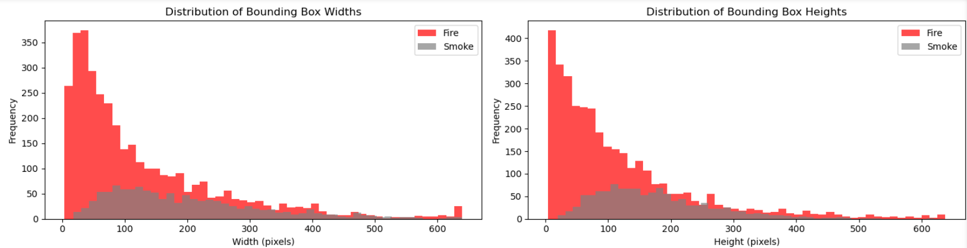
Histograms (bounding box dimensions)

Slide 13
Cont__
ii. Bivariate Analysis
This analysis examined the relationship between two variables. A key finding came from comparing the average pixel intensity (Red, Green, and Blue) of images for the fire and smoke classes.
Box plots showed that fire images had significantly higher average red values, while smoke images were characterized by a more neutral, grayish color profile. This confirmed that color is a strong distinguishing feature.

Slide 14
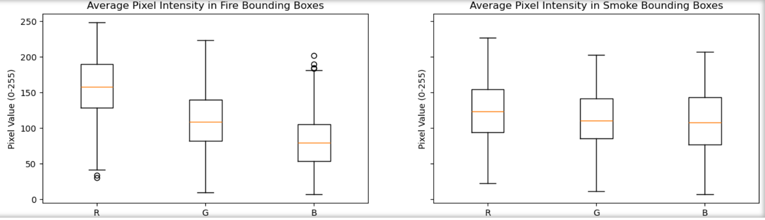
Box Plots (Pixel Intensity by Class)

Slide 15
Cont__
iii. Multivariate Analysis
This analysis looked at the relationships between three or more variables simultaneously.
I visualized the connection between the size, aspect ratio, and class of the bounding boxes in a scatter plot. This showed that while fire instances were concentrated in a narrow range of sizes and shapes, smoke instances occupied a much wider and more varied distribution of dimensions, which is a crucial insight for the object detection model.

Slide 16
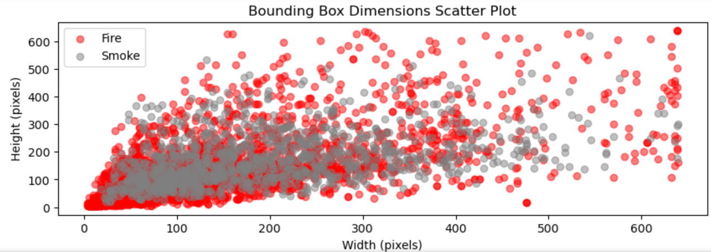
Scatter Plots

Slide 17
Feature Engineering Techniques
Handling missing values
There is no missing values in my dataset(No corrupted files found)
Handling Outliers
Outliers are data points that are statistically unusual but may still be valid. For example, a fire that is extremely large or a smoke plume that is unusually shaped.

Slide 18
Cont__
Option 1: Keep them. If the outliers represent rare but valid real-world scenarios (e.g., a massive wildfire), it's often best to keep them. Keeping them helps your model become more robust and generalize better to real-world edge cases. Removing them might make the model brittle.
Conclusion: ---->Due to the nature of my project, the best approach is to keep the outliers but be aware of them.

Slide 19
Cont__
Option 2: Cap or transform. If an outlier is an extreme value that could skew your model (e.g., a bounding box with a large aspect ratio),to consider capping its values.
This is more common in tabular data but can be applied to derived features. For a deep learning model, simply keeping the image and letting the model handle it, is usually a better approach

Slide 20
Cont__
Handling Anomalies
Anomalies are data points that are simply incorrect and can harm your model's performance. The most common anomalies are mislabeled images or incorrect bounding boxes.
Option 1: Removal. The most effective way to handle anomalies is to manually remove them from your dataset. A mislabeled image (e.g., a sunset labeled as 'fire') will teach your model the wrong thing, leading to incorrect predictions.

Slide 21
Cont__
Option 2: Re-labeling. If an image is mislabeled, but the content is good (e.g., a fire image labeled 'smoke'), you should re-label it correctly. This turns a bad data point into a valuable one.
Conclusion---> My dataset images are correctly labeled and have good annotations. No corrupted or unreadable image files were found, indicating a clean dataset with no missing values

Slide 22
Cont__
Data transformation
It involves modifying your images and their corresponding annotations to create a standardized format that a deep learning model can effectively learn from.
==➔One-Hot Encoding
One-hot encoding creates new binary columns, one for each unique category in a feature. For a given data point, a 1 is placed in the column corresponding to its category, and 0s are placed in all other new columns. This method is ideal when there is no inherent order between the categories.

Slide 23
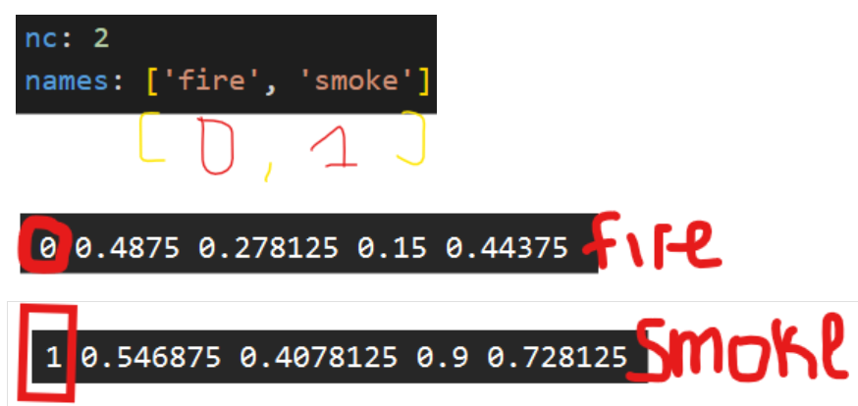

Slide 24
Model building and evaluation process
Model Choice:
A Convolutional Neural Network (CNN) was selected for its ability to process spatial data.
I used YOLOv8 due to its reputation as a leading model for real-time object detection.

Slide 25
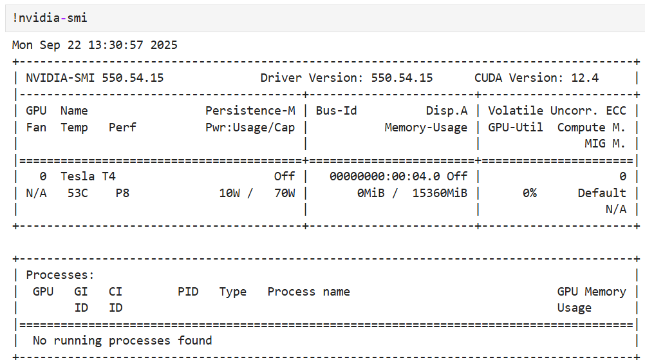
Cont__
Model Training
Step1: Setting runtime on GPU from google colab

Slide 26
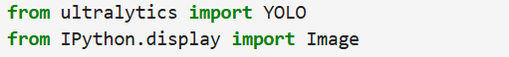
Cont__
Step2: Installation of required libraries

Slide 27
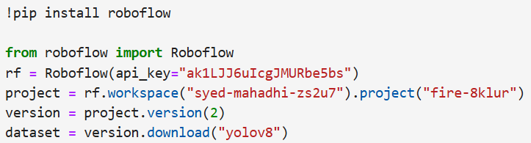
Cont__
Step3: Downloading dataset from Roboflow universe

Slide 28
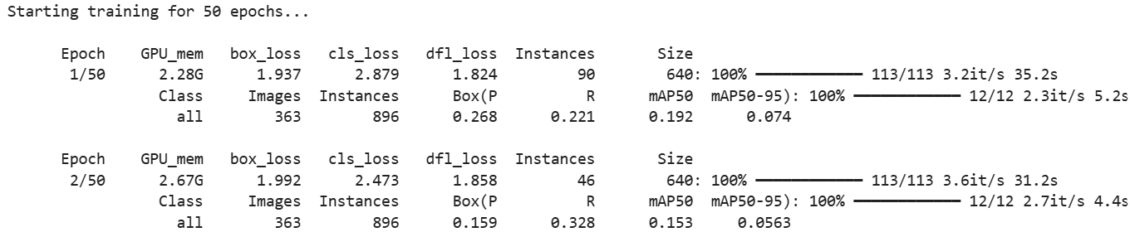
Step4: Training the dataset
Cont__
Starting from 1-to-50 Epochs

Slide 29
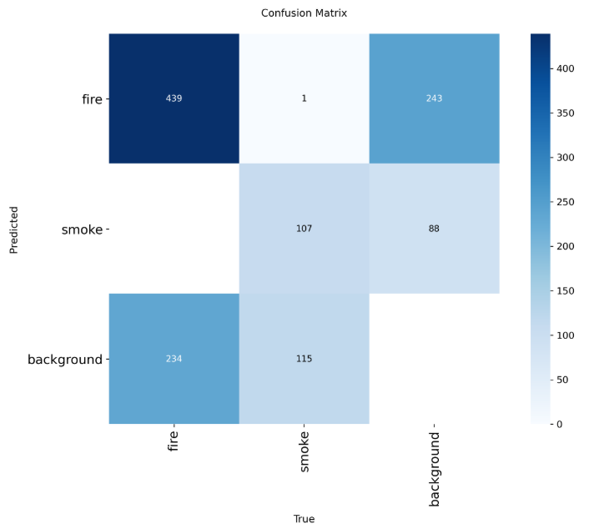
Cont__
Model Evaluation
1. Confusion matrix

Slide 30
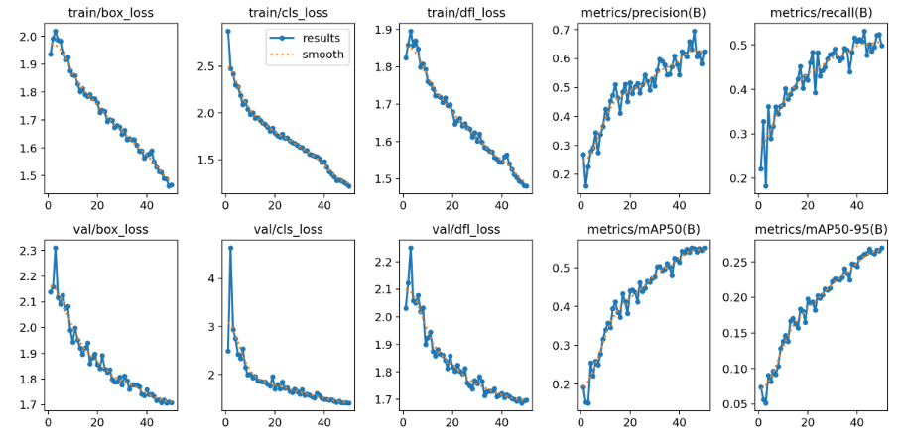
Cont__
2. Metrics

Slide 31
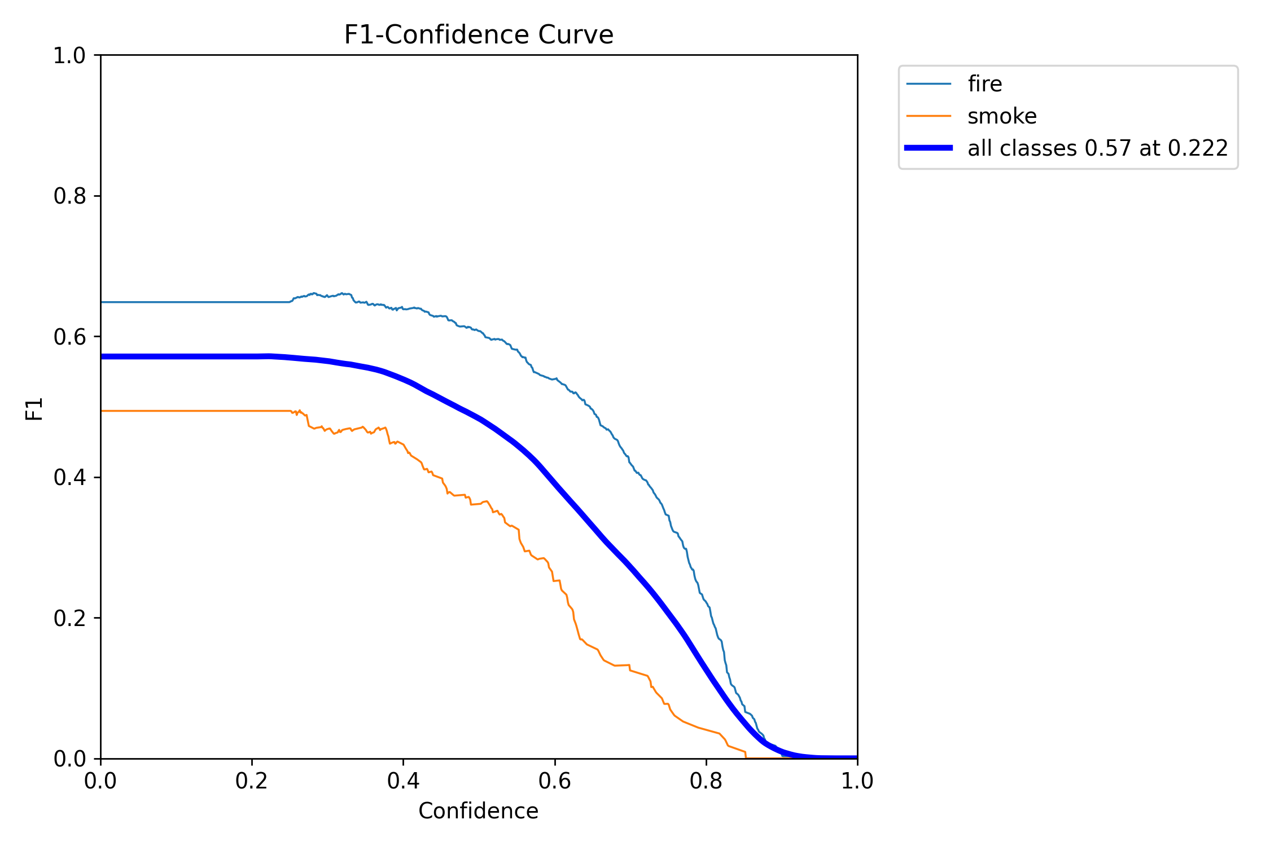
Cont__
3. F1-Confidence Curve

Slide 32
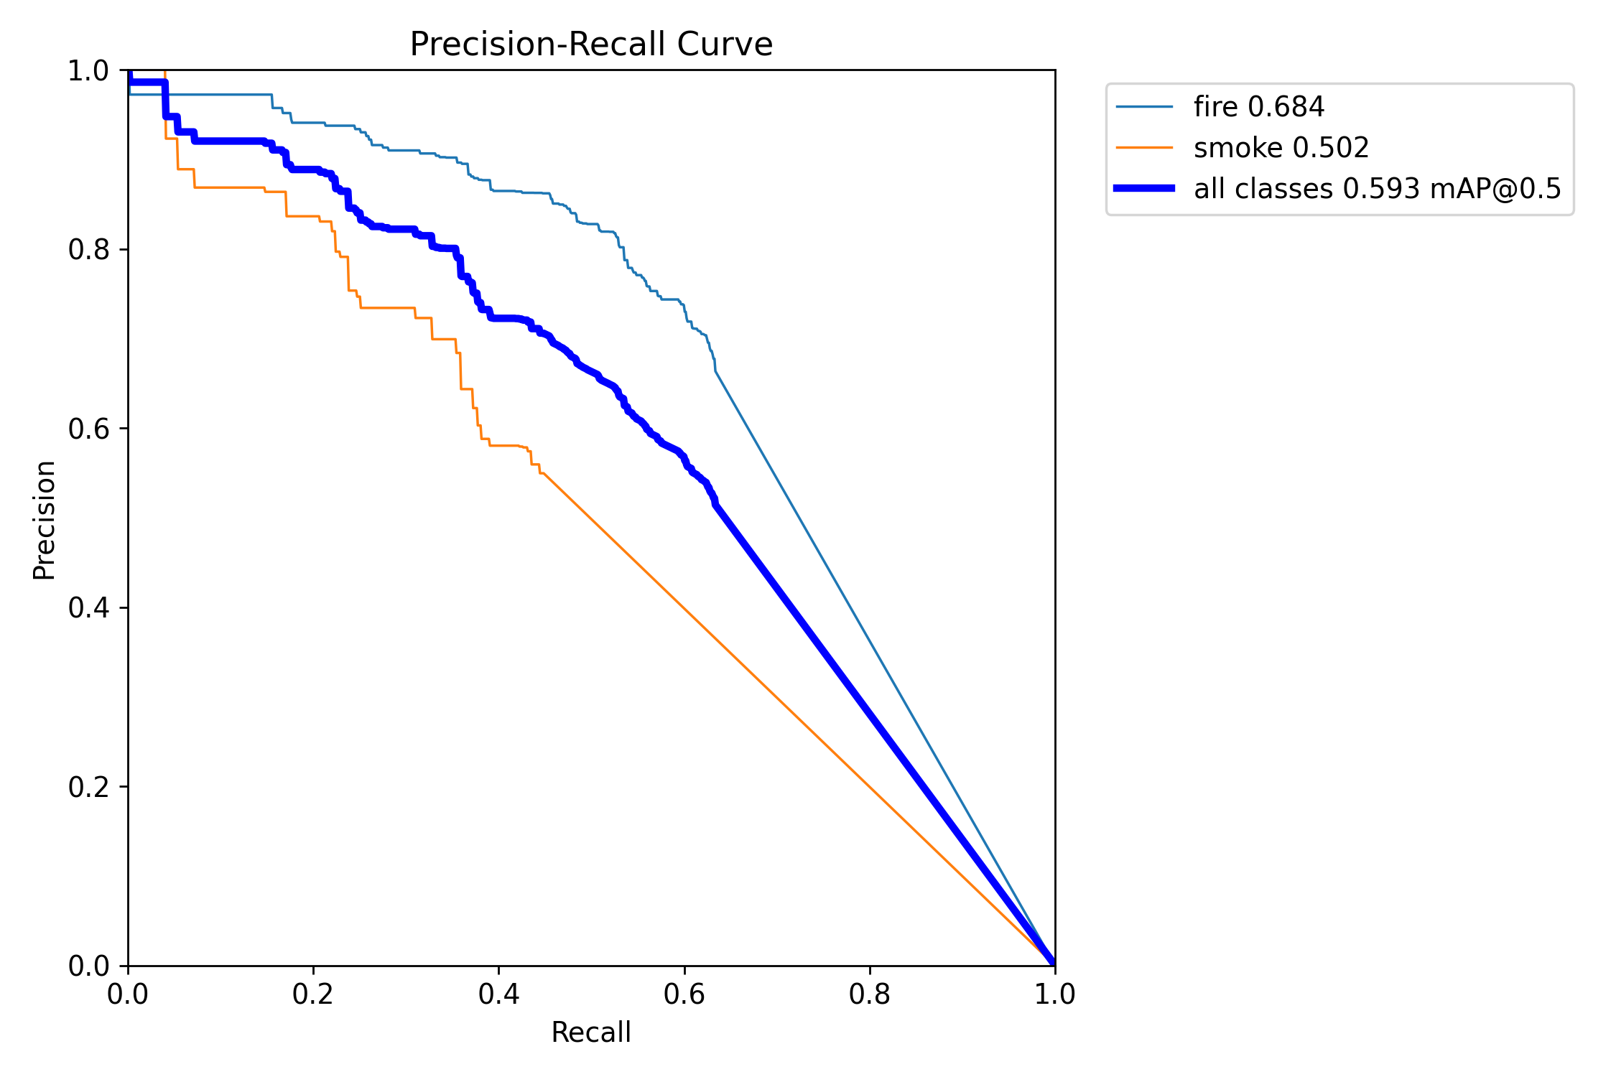
Cont__
4. Precision-Recall Curve

Slide 33
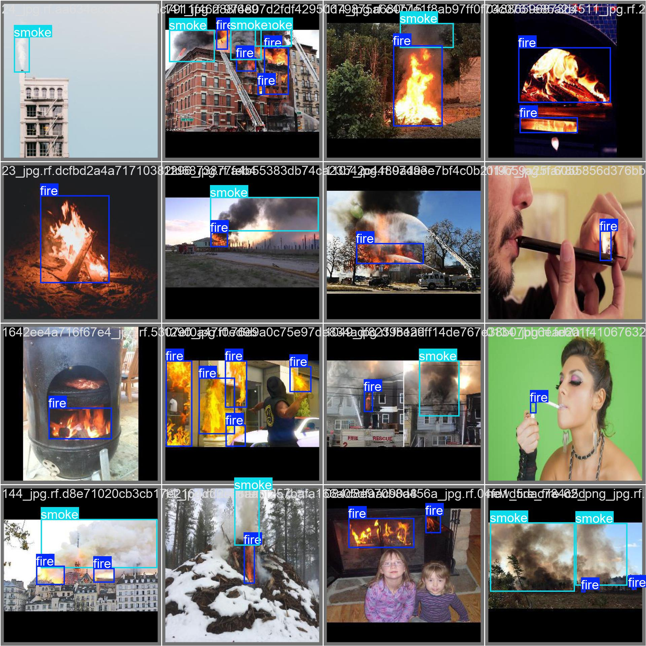
Cont__
5.Labeling

Slide 34
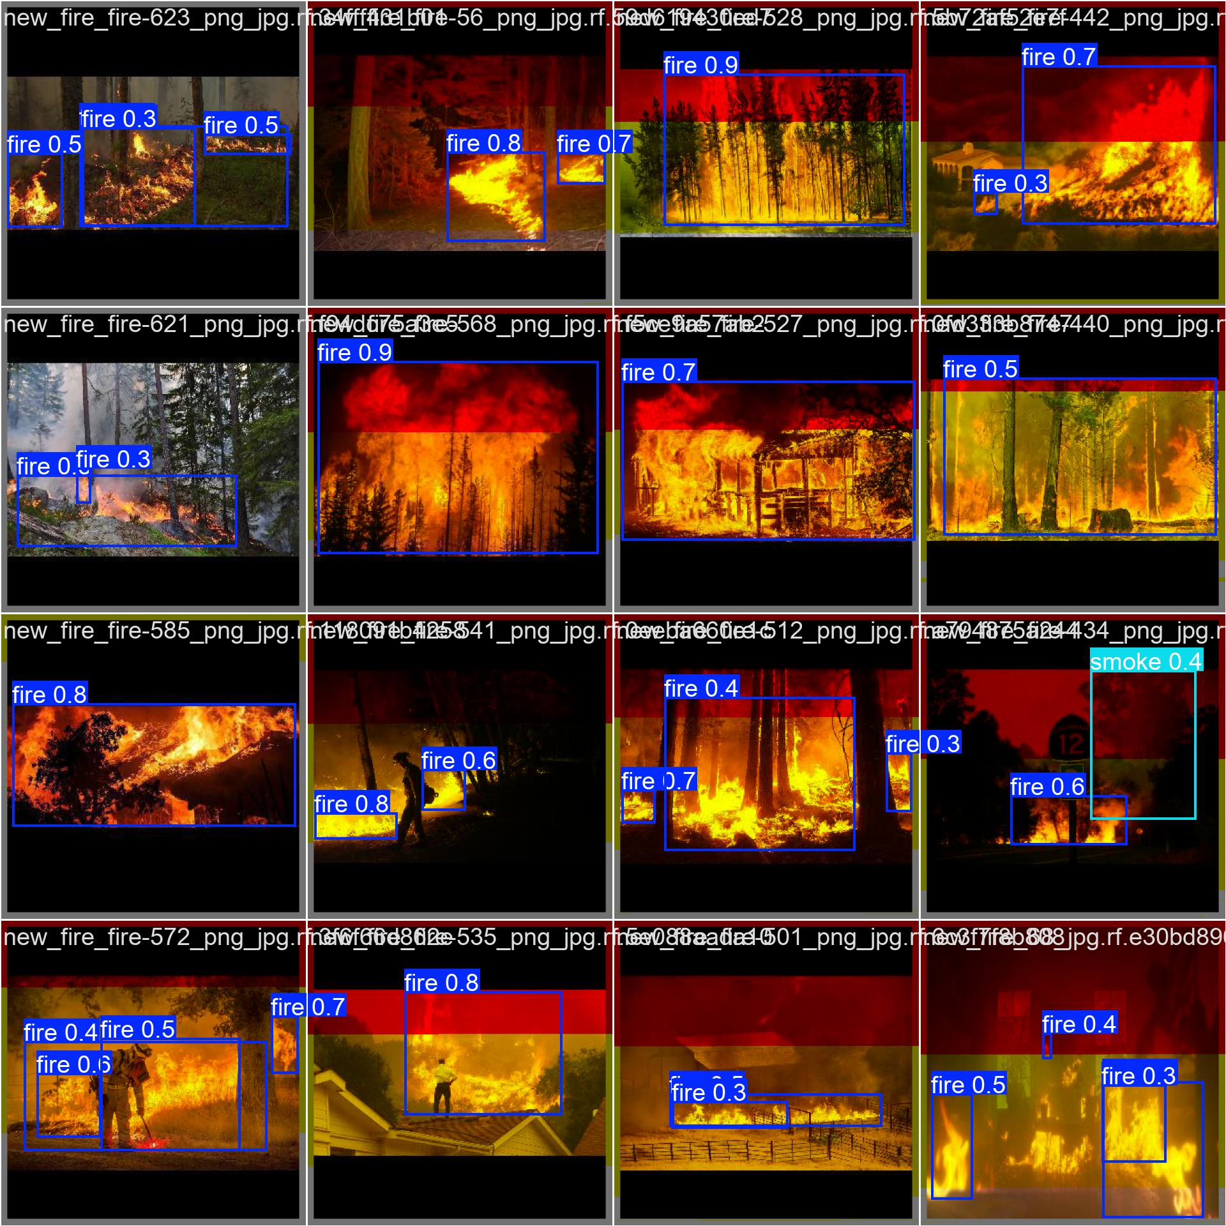
Cont__
6.Prediction

Slide 35
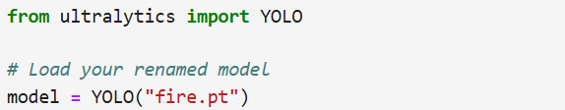
Cont__
Evaluate with running inferences
After training the model, it saved as best.pt and I prefer to change the model's name as fire.pt

Slide 36
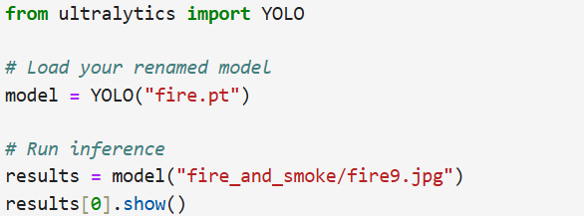
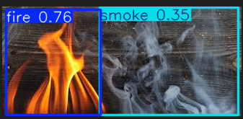
Cont__
Running inference with a YOLO model using single image
result➔

Slide 37
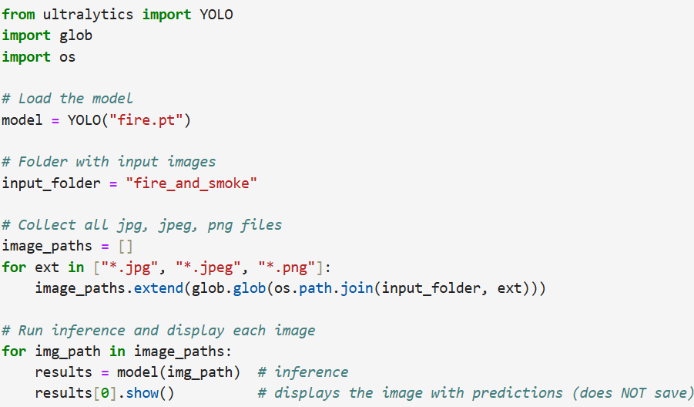
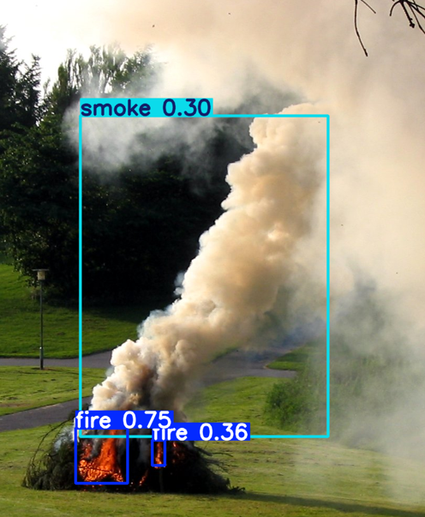
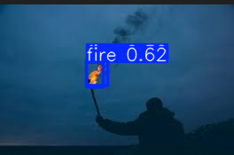
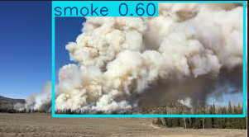
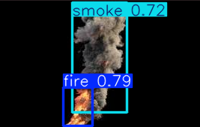
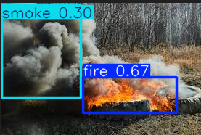
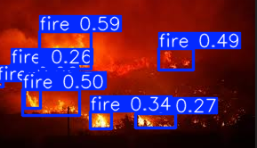
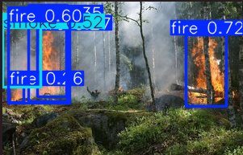
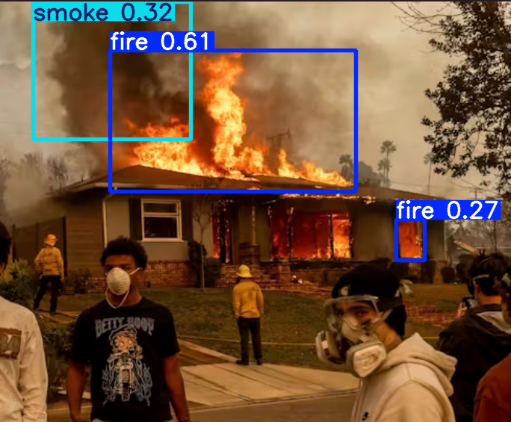
Cont__
Running inference with a YOLO model using multiple images results➔
➔

Slide 38
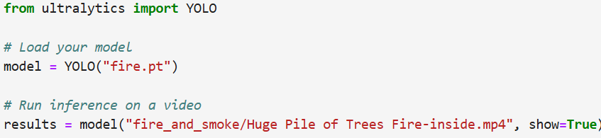
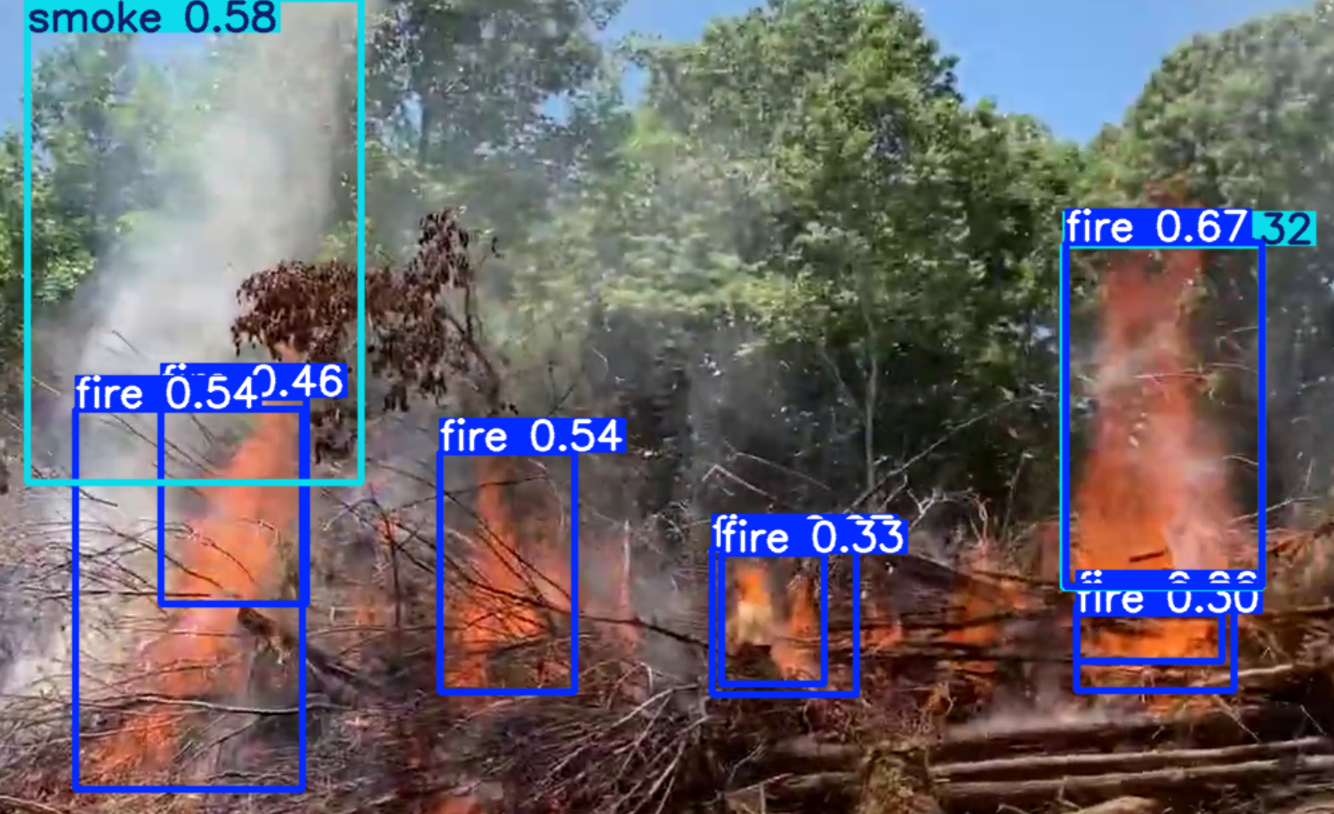
Cont__
Running inference with a YOLO model using video
result➔

Slide 39
Model deployment
Model locally using Streamlit and GitHub
Step 1: Organize your project folder
├─ fire.pt # Your trained YOLO model
├─ app.py # Your Streamlit application
├─ requirements.txt # Python dependencies
Step 2: Write your Streamlit app (app.py)
Step 3: Create requirements.txt
This file lists all Python dependencies:
Streamlit, ultralytics, opencv-python, Pillow

Slide 40
Cont__
Step 4: Initialize Git repository
In your project folder:
git init
git add .
git commit -m "Initial commit of fire detection app“
Step 5: Push to GitHub
git remote add origin https://github.com/your-username/fire-detection.git
git branch -M main
git push -u origin main

Slide 41
Cont__
Step 6: Install dependencies locally
Create a virtual environment (optional but recommended):
python -m venv myvenv
venv\Scripts\activate # Windows
Install requirements:
pip install -r requirements.txt

Slide 42
Cont__
Step 7: Run Streamlit locally
streamlit run app.py
This will open a local URL (usually http://localhost:8501) in your browser.
You can upload images and test fire detection locally.

Slide 43
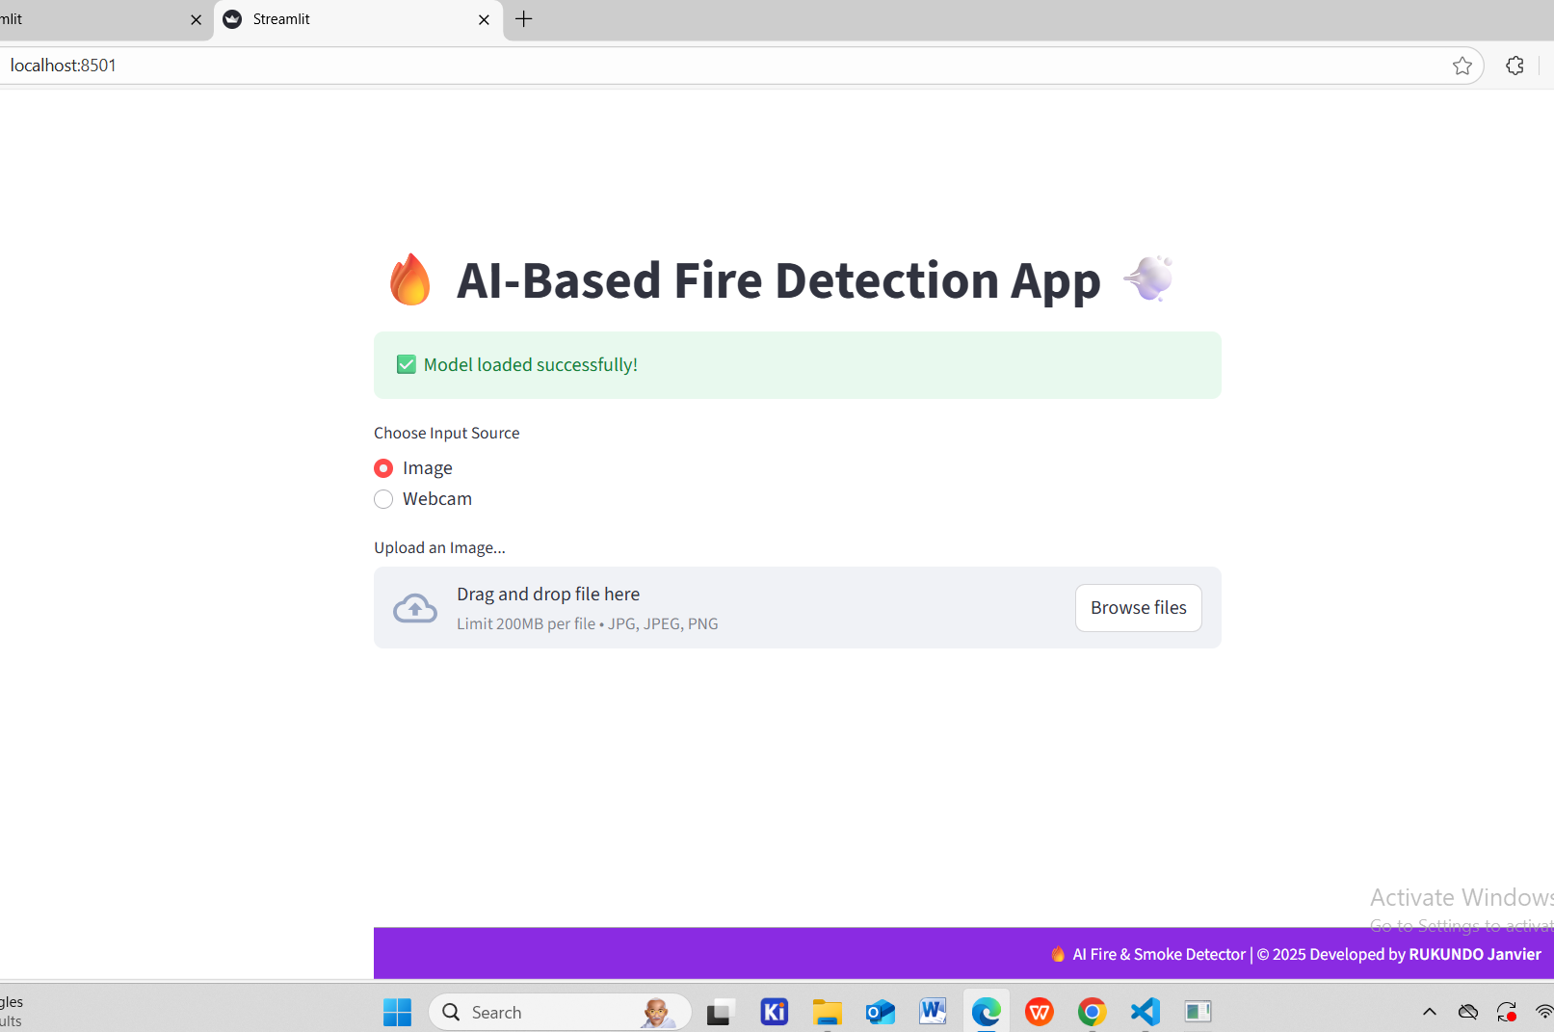
Cont__
Local Deployment Test

Slide 44
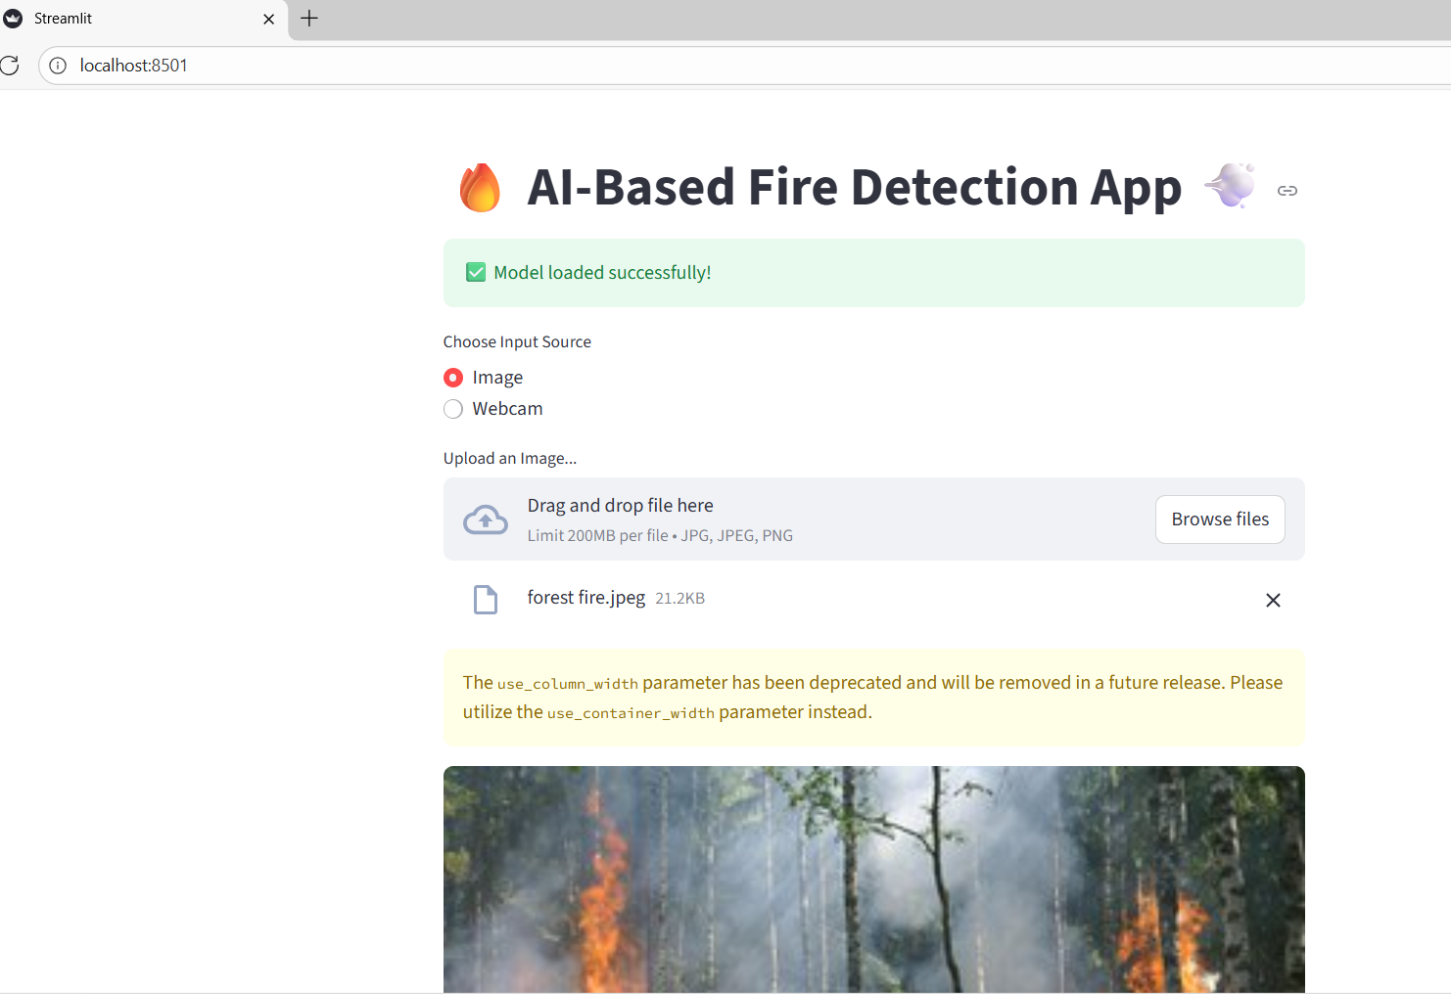
Cont__
Locally Image Test

Slide 45
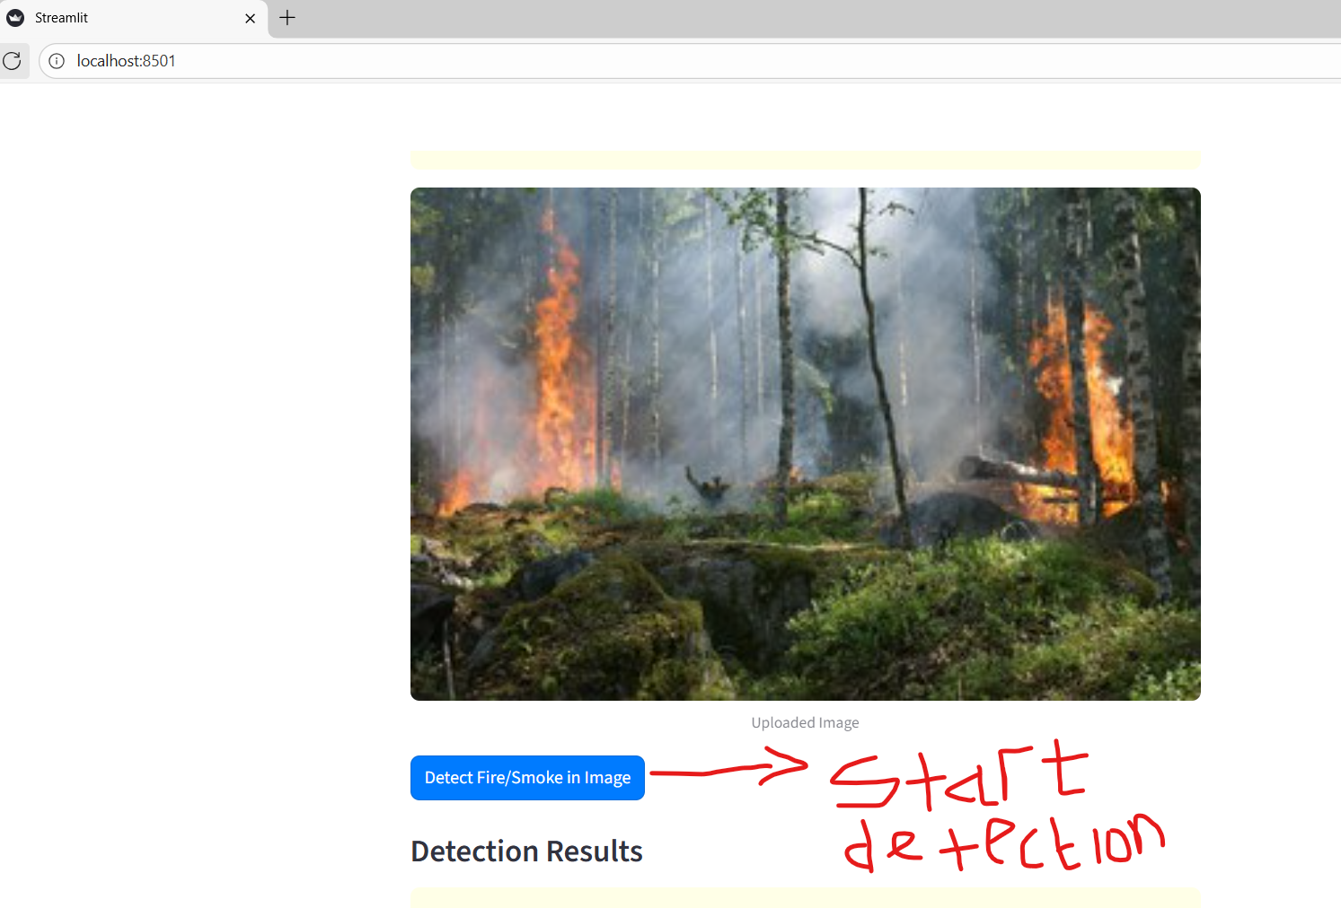
Cont__

Slide 46
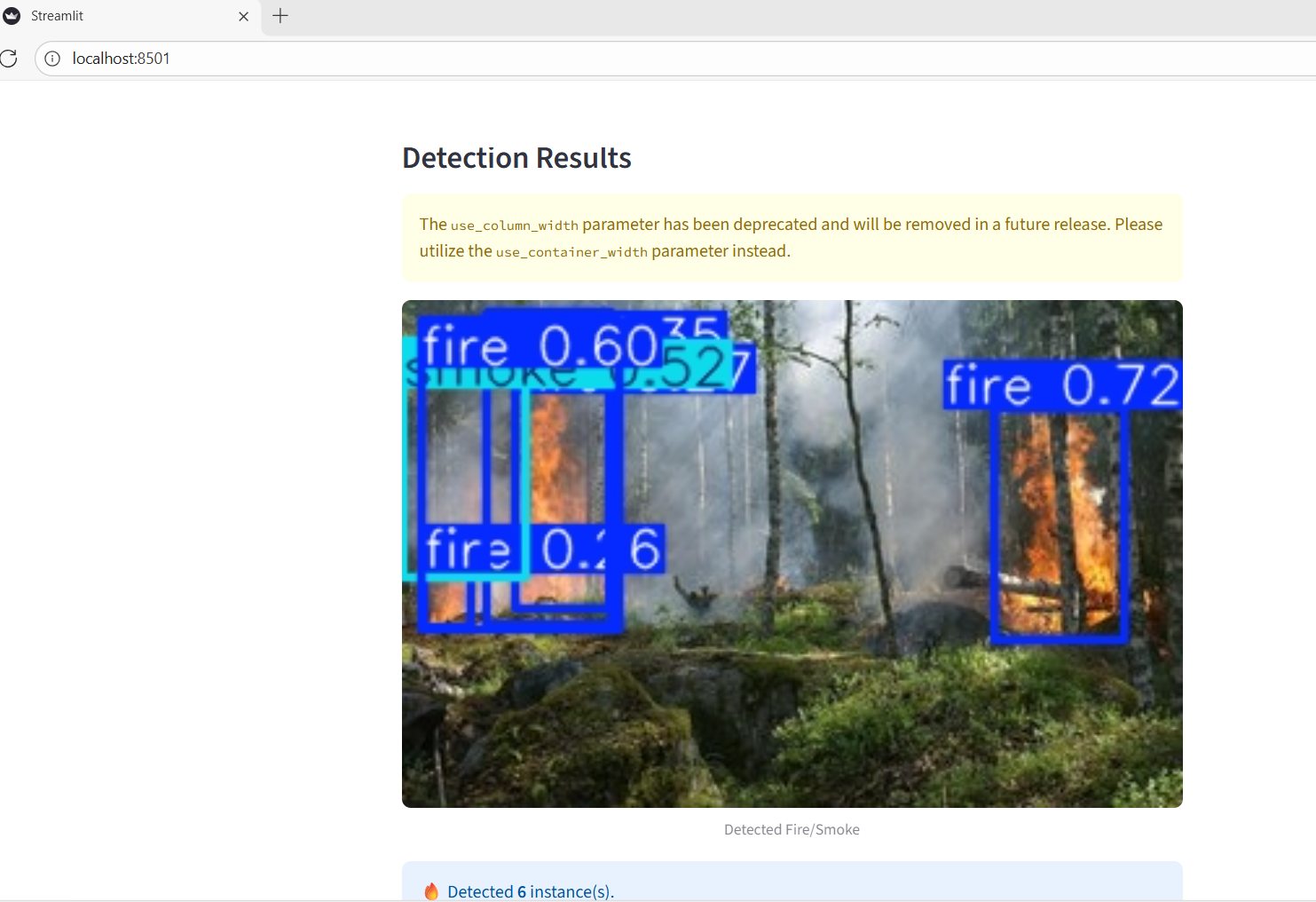
Cont__

Slide 47
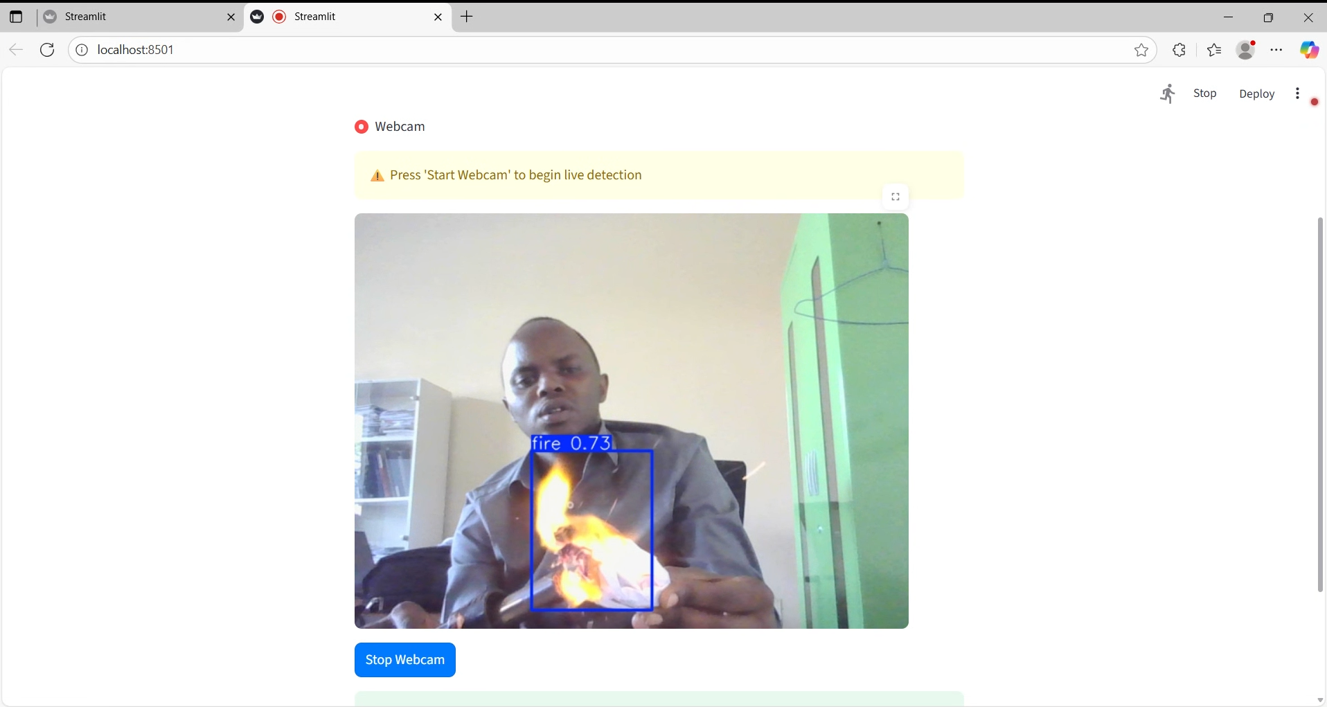
Cont___
Local Deployment Test using Webcam

Slide 48
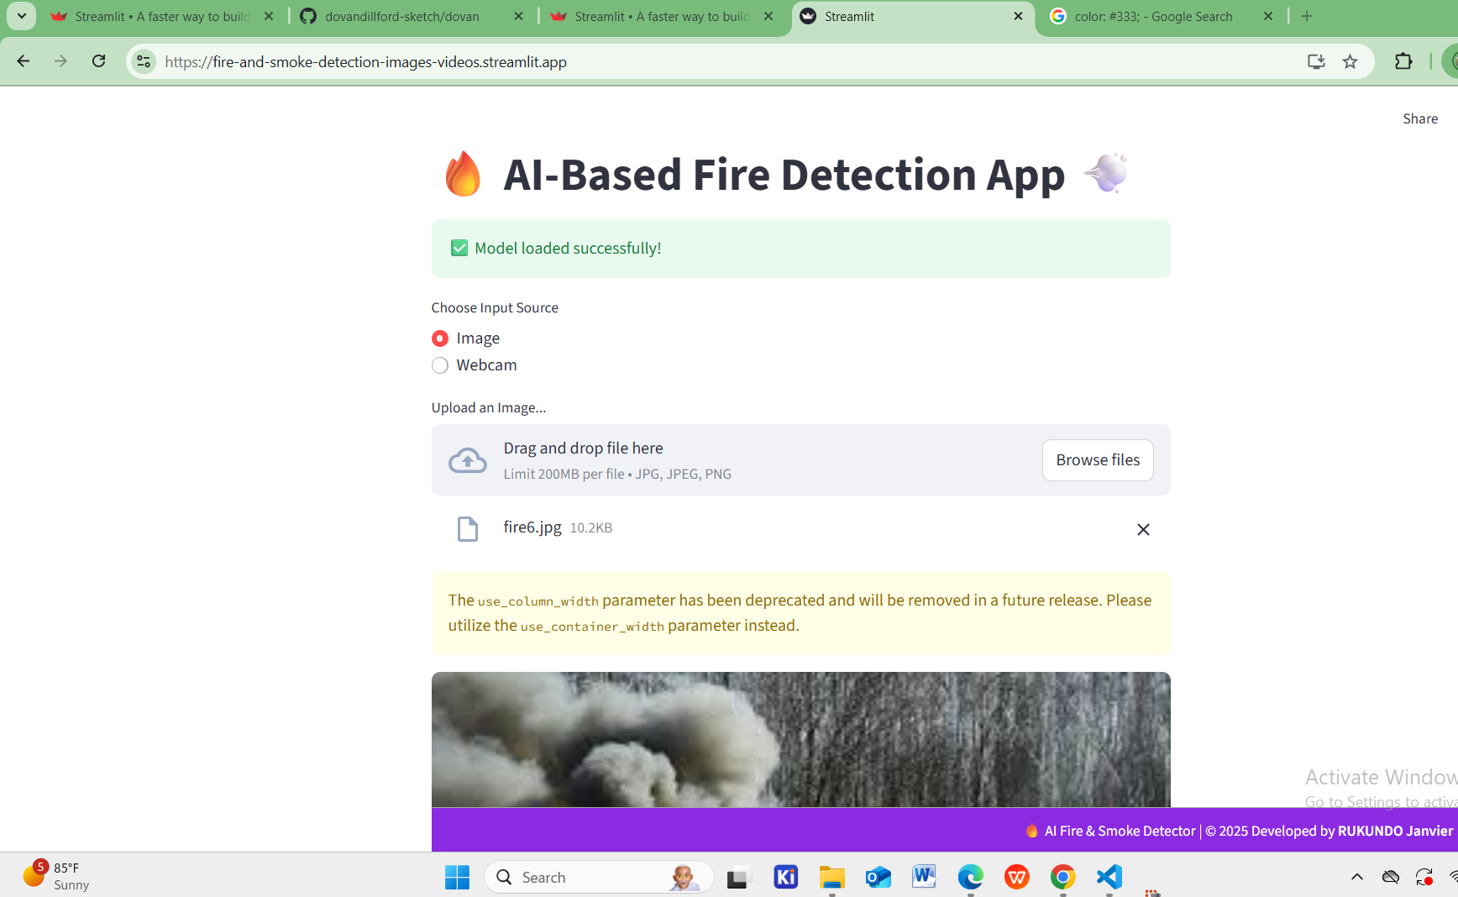
Cont__
Public Deployment Test using Image

Slide 49
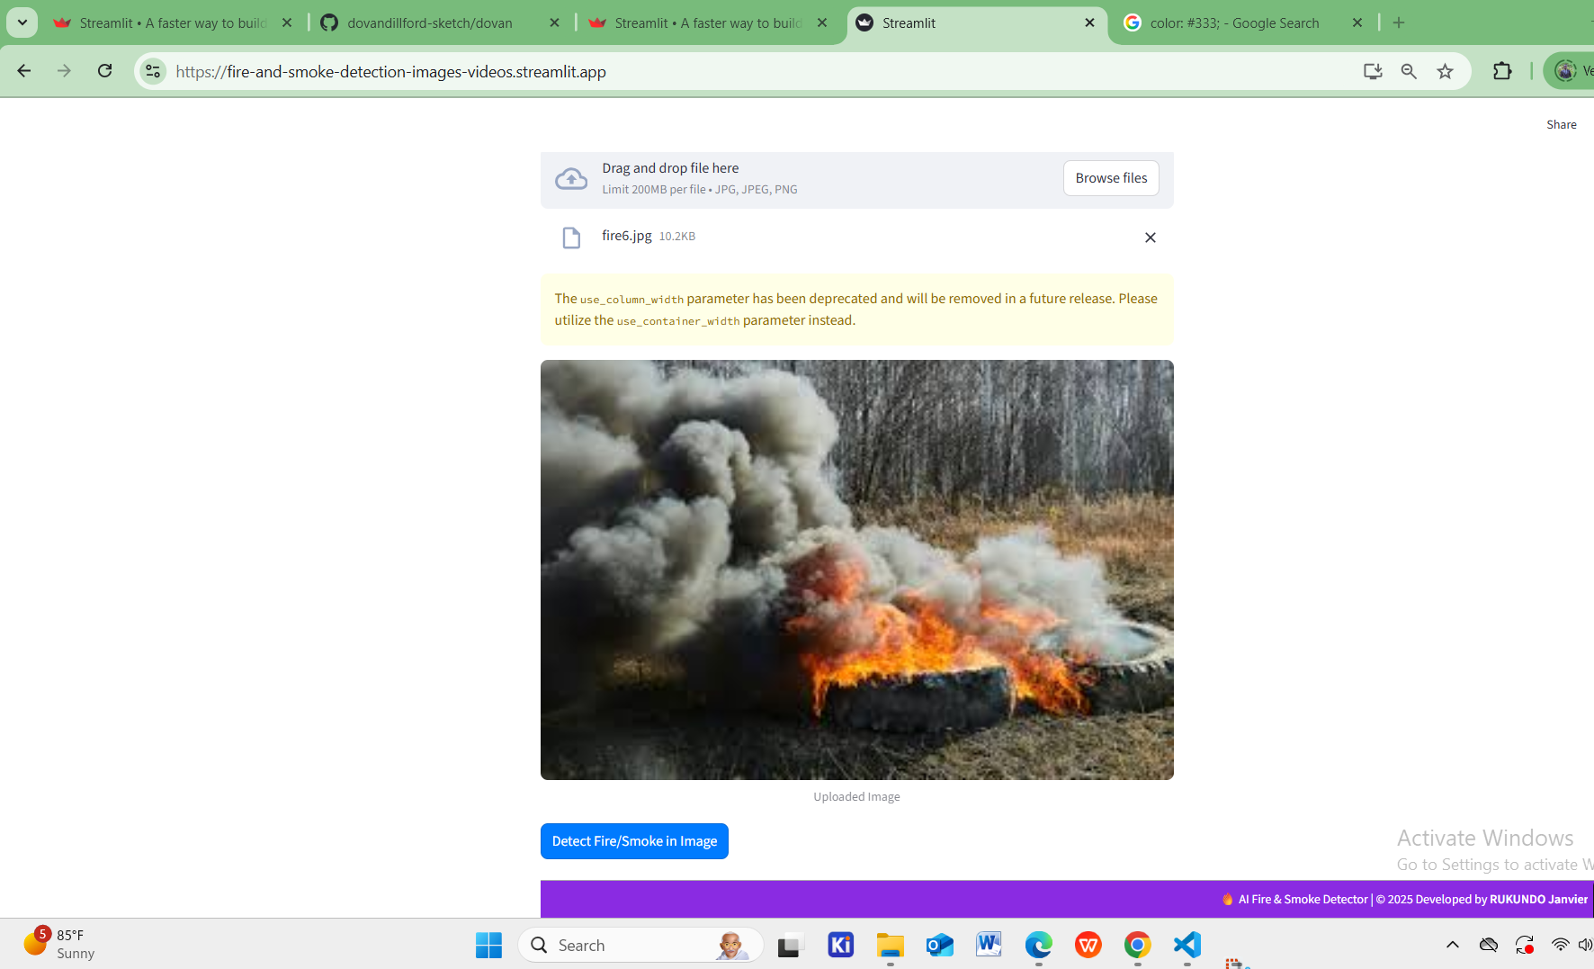
Cont__

Slide 50
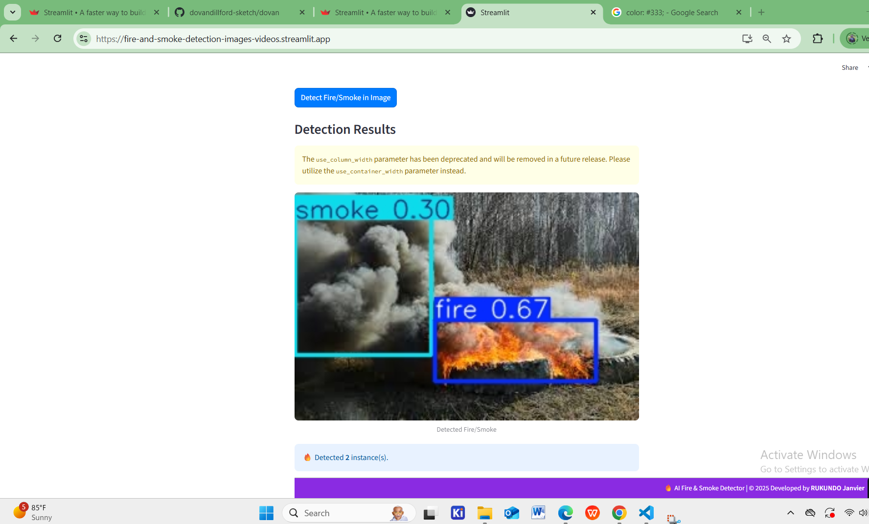
Cont__

Slide 51
Cont__
Public Deployment Test using Webcam
webcam access usually doesn’t work when deployed publicly on cloud platforms like Streamlit Cloud or GitHub Pages
The webcam is part of the computer. Streamlit running on the cloud cannot access the local webcam.
Streamlit Cloud / public hosting is remote app runs on a server in the cloud. The server has no access to the personal camera.

Slide 52
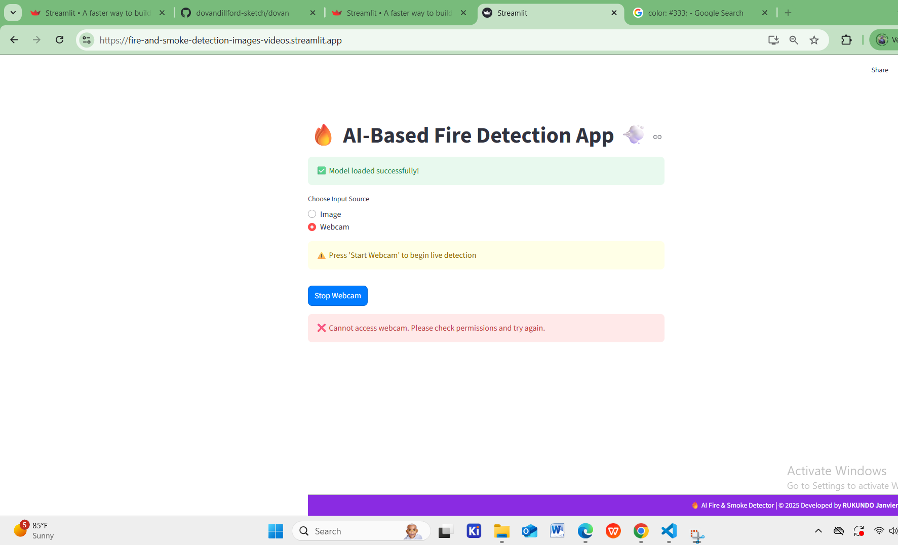
Cont__
Webcam to public host deployment

Slide 53
Thank you!!

